Slide 1
NHẬP MÔN BIG DATA
GV:
Mail:

Slide 2
NỘI DUNG MÔN HỌC
Chương 1. Tổng quan về Dữ liệu lớn
Chương 2. Phân tích liên kết
Chương 3. Kỹ thuật lưu trữ
Chương 4. Xử lý dữ liệu lớn trên Apache Spark
Chương 5. Kỹ thuật trong xử lý dữ liệu lớn

Slide 3
TÀI LIỆU THAM KHẢO
Sách, giáo trình chính:
[1] Jure Leskovec, Anand Rajaraman, Jeffrey D. Ullman, Mining of Massive Datasets, Stanford University, 2019.
Tài liệu tham khảo:
[1] Đỗ Phúc, Giáo trình phân tích dữ liệu lớn, Nhà xuất bản Đại học Quốc gia TP.HCM, 2022.
[2] Mayank Bhushan, Big Data and Hadoop: Learn by example, BPB Publications, 2019.

Slide 4
Đánh giá môn học
  Điểm quá trình 50%
  1. Điểm danh: 20%
  1. Điểm kiểm tra: 80%
  Điểm cuối kỳ 50%
  2. Điểm trình bày chủ đề (2 HV/nhóm): 30%
  2. Điểm đồ án môn học (2 HV/nhóm): 70%
  + Điểm cộng cho thành viên tích cực tham gia trao đổi: 1 điểm

Slide 5
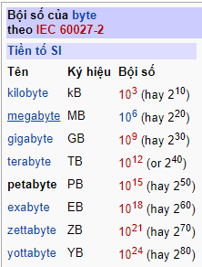
Binary Digit

Slide 6

The current state of data

Slide 7
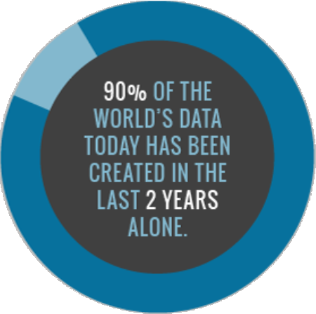
The growth of data
Every day we create
2,500,000, 000,000, 000,000
(2.5 quintillion)
This would fill 10 million blu-ray discs
The height of which stacked, would measure the height of 4 Eiffel Towers

Slide 8

Data volume (scale)
Data Volume
+ 44 x increase from 2009 to 2020
+ From 0.8 zettabytes to 35zb
Data volume is increasing exponentially.

Slide 9
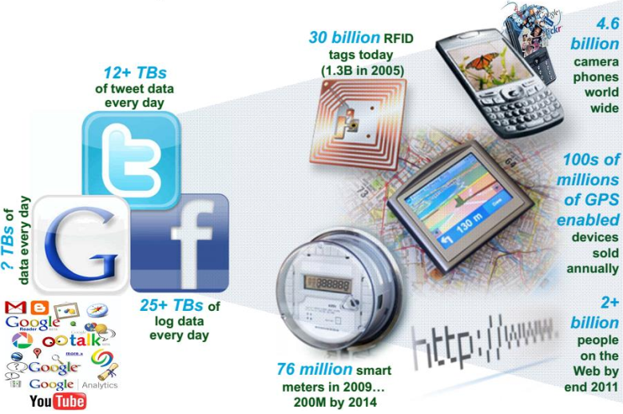
The social layer in an instrumented interconnected world

Slide 10
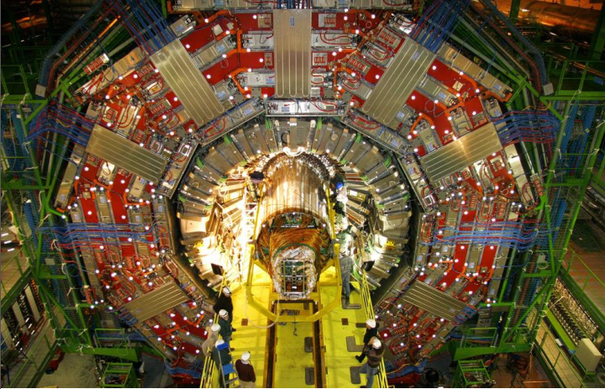
The Large Hadron Collider (LHC) generates 30 Petabytes a year

Slide 11
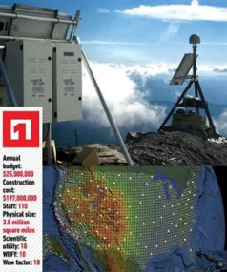
The Earthscope project
It is largest science project in the world.
+ Designed to track North America's
Geological.
+ This observatory records data over
3.8 million square miles, 67 terabytes of data

Slide 12
Other statistics of data growth
The New York Stock Exchange generates about 4-5 terabytes of data per day.
Facebook hosts more than 240 billion photos, growing at 7
petabytes per month.
Ancestry.com, the genealogy site, stores around 10 petabytes of data.
The Internet Archive stores around 18.5 petabytes of data

Slide 13
Data complexity (Variety)
Various formats, types, and structures
Text, numerical, images, audio, video,
Sequences, time series, sensor data, user logs, social media data.
A single application can be generating/collecting many types of data.
To extract knowledge → all these types of data need to linked together

Slide 14
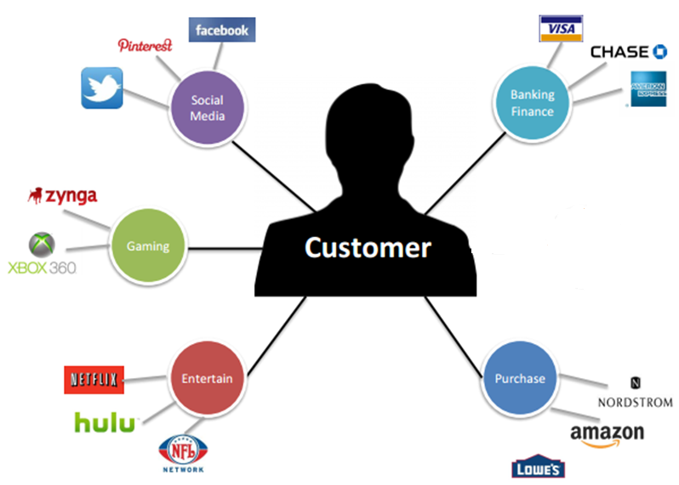
A single view to the customer

Slide 15
Data speed (Velocity)
Data is begin generated fast and need to be processed fast.
+ Online Data Analytics
+ Late decisions → missing opportunities

Slide 16
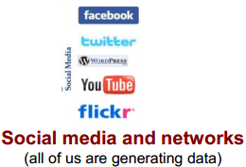
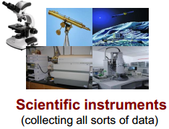
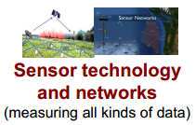
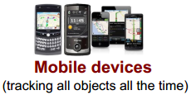
Real-time/Fast data

Slide 17
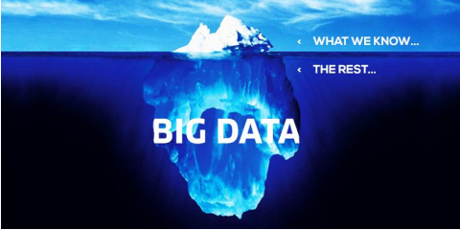
An overview of Big Data

Slide 18
Concept of “Big Data”
Big data is a term for data sets that are so large or complex that traditional data processing application software are inadequate to deal with them.

Slide 19
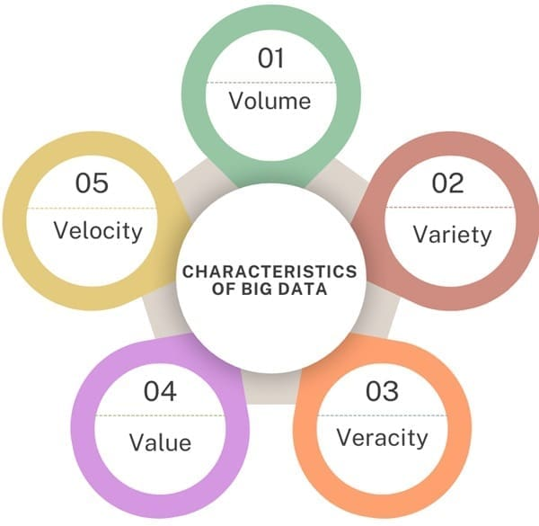
Characteristics of Big Data

Slide 20
Characteristics of Big Data
Volume: The massive size and sheer quantity of data, often measured in terabytes, petabytes, or exabytes.
Velocity: The high speed at which new data is created, collected, and streamed in real-time.
Variety: The different types and formats of data, including structured tables, semi-structured files, and unstructured text, audio, or video.
Veracity: The trustworthiness, quality, and accuracy of the collected data.
Value: The practical business worth or actionable insights gained after analyzing the raw data.

Slide 21
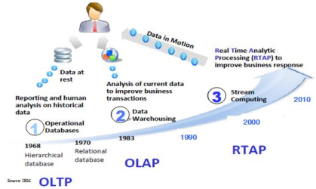
Harnessing Big Data
OLTP: Online Transaction Processing (DBMSs)
OLAP: Online Analytical Processing (Data Warehousing)
RTAP: Real-Time Analytics Processing (Big Data Architecture &
technology)

Slide 22


Who is generating Big Data?
Old model: Few companies are generating data, all others are consuming data.
New model: All of us are generating data, and all of us are
consuming data

Slide 23
Challenges in handling Big Data
New architecture, algorithms, techniques are needed
Lack of experts in using the new technology and dealing with big data
Efficiently storing and accessing large amounts of data is
difficult
Managing metadata for semi-structured and unstructured data, generated by diverse sources, is a convoluted problem

Slide 24
Techniques towards Big Data
Parallel
Huge Data Volumes Storage
Data Distribution
High-Speed Networks
High-Performance Computing
Task and Thread Management
Data Mining and Analytics
Machine Learning
Data Visualization

Slide 25
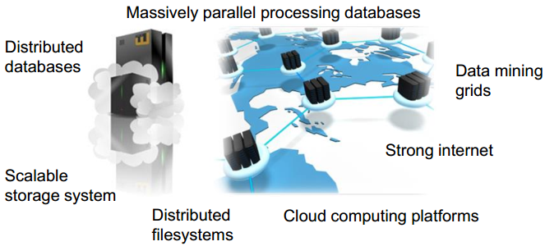
Big Data platform
Technologies applied to Big Data should include

